Slide 1
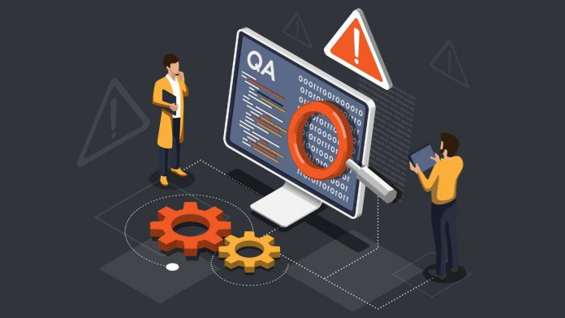
Chapter 2
Chapter 2
TESTING THROUGHOUT THE SOFTWARE LIFE CYCLE
2.3 Test Types: The Targets Of Testing
2.4 Maintenance Testing
Group 4 – SWT301
Nguyen
Tran Phong
Vo Van
Thanh Phuc
Mai
Thanh Hoang
Tran
Tan Long

Slide 2
Content
2.3 Test Types: The Targets Of Testing
2.4 Maintenance Testing
2.3.1 Testing of Function (Functional Testing)
2.3.2 Testing of Software Product Characteristics (Non-Functional Testing)
2.3.3 Testing of Software Structure / Architecture (Structural Testing)
2.3.4 Testing Related to Changes (Confirmation and Regression Testing)
2.4.1 Impact Analysis and Regression Testing
2.4.2 Triggers for Maintenance Testing
Chapter 2
Chapter 2
TESTING THROUGHOUT THE SOFTWARE LIFE CYCLE

Slide 3


2.3 Test Types: The Targets Of Testing
2.3.1 Testing of Function (Functional Testing)
The function of a system
Software Requirements
Specification (SRS)
“what it does”
Suitability
Accuracy
Security
Interoperability
Compliance
Functional Specification
Use Cases

Slide 4



2.3 Test Types: The Targets Of Testing
2.3.1 Testing of Function (Functional Testing)
REQUIREMENTS-BASED
BUSINESS-PROCESS-BASED
Tests on each function / feature of the system.
Tests on the entire system rather than a single feature.
Uses a specification of the functional requirements for the system as the basis for designing tests.
Uses knowledge of the business processes, which support the company’s strategy.
Prioritize the requirements based on risk criteria and use this to prioritize the tests.
What to test?
Which is important?
Which is not important?
Use cases are a very useful basis for test cases from a business perspective.
What not to test?

Slide 5
2.3 Test Types: The Targets Of Testing
2.3.2 Testing of Software Product Characteristics (Non-Functional Testing)
How well the system / the feature works
How fast the system / the feature works
We need to measure on a scale of measurement

Slide 6
2.3 Test Types: The Targets Of Testing
2.3.2 Testing of Software Product Characteristics (Non-Functional Testing)
Non-Functional Testing
Performance testing
Usability testing
Maintainability testing
Load testing
Reliability testing
Stress testing
Portability testing
Efficiency testing
Understandability
Learnability
Operability
Attractiveness
Compliance
Analyzability
Changeability
Stability
Testability
Compliance
Maturity (robustness)
Fault-tolerance
Recoverability
Compliance
Adaptability
Installability
Co-existence
Replaceability
Compliance
Time behavior (performance)
Resource utilization
Compliance
http://bit.ly/NonFunctionalTestingDetails

Slide 7
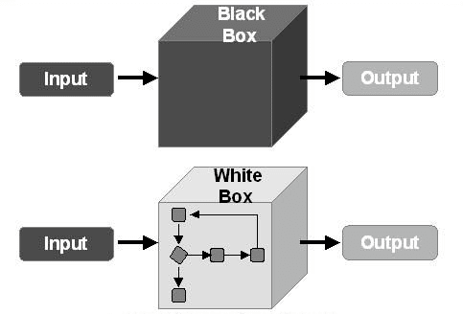
2.3 Test Types: The Targets Of Testing
2.3.3 Testing of Software Structure / Architecture (Structural Testing)
Structural tests are often referred to as “white boxes” or “glass boxes”.
Structural testing is often used as a measure of testing.
It can happen at any level of testing, mainly in component testing, integration.

Slide 8

2.3 Test Types: The Targets Of Testing
2.3.3 Testing of Software Structure / Architecture (Structural Testing)
Coverage metrics measure the percentage of executions that have been performed by a test suite.
If the coverage is not 100%, then additional tests may need to be written and run to cover the unexecuted parts.
The techniques used for structural testing are white box testing, control flow models commonly used to support structural testing.

Slide 9
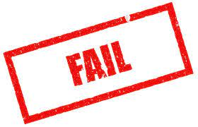




2.3 Test Types: The Targets Of Testing
2.3.4 Testing Related to Change (Confirmation and Regression Testing)
CONFIRMATION TESTING (RE-TESTING)
01
Test fail
02
Determine the cause
03
The bug is reported
04
New version (fixed bug)
05
Re-testing

Slide 10

2.3 Test Types: The Targets Of Testing
2.3.4 Testing Related to Change (Confirmation and Regression Testing)
REGRESSION TESTING
Like confirmation testing, regression testing involves the execution of previously executed test cases.
The difference is that for regression testing, the test cases may be true the last time they were executed.
Purpose
Verify that modifications in the software or the environment do not cause unintended adverse effects and that the system still meets its requirements.

Slide 11
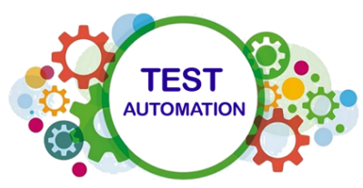
2.3 Test Types: The Targets Of Testing
2.3.4 Testing Related to Change (Confirmation and Regression Testing)
REGRESSION TESTING
All the cases in the regression test suite will be executed every time a new version of the software is released and this makes them ideal for automation.
Bug fixes
Regression Testing
Software changes
New functionality
Environment changes

Slide 12
2.4 Maintenance Testing
A receipt of an Application Change
Product Manager
Make Test plan
Testing
System is updated
Maintenance Testing
Component Test
Integration Test
System Test
Acceptance Test

Slide 13
2.4 Maintenance Testing
2.4.1 Impact Analysis and Regression Testing
The most important activity
After tests for any changes on the operational system, maintenance testing often includes regressive tests.
Develop teams together with stakeholders decide on which part of the systems needs to be regressively tested.
⇒ Help to focus on where to make regressive tests.
Show if the rest of the system has been affected by the maintenance work or not.
If test specifications from the original development are still kept, we can adapt it to the changes of the system, or build new test cases in case of extending or enhancement of the systems.

Slide 14



2.4 Maintenance Testing
2.4.2 Triggers for Maintenance Testing
TRIGGERS
Maintenance testing is done on an existing operational system.
Modifications
Maintenance Testing
Migration
Retirement

Slide 15
2.4 Maintenance Testing
2.4.2 Triggers for Maintenance Testing
TRIGGERS
Modifications
Migration
Retirement
Planned Enhancement Changes
Release-based
Corrective and Emergency Changes
Changes of Environment
Planned Operating System (OS) Upgrades
Database Upgrades
Patches to Newly Exposed
Discovered Vulnerabilities of OS

Slide 16
2.4 Maintenance Testing
2.4.2 Triggers for Maintenance Testing
TRIGGERS
Modifications
Migration
Retirement
Operational Testing of The
New Environment
Operational Testing of The Changed Software

Slide 17
2.4 Maintenance Testing
2.4.2 Triggers for Maintenance Testing
TRIGGERS
Modifications
Migration
Retirement
The Testing of Data Migration
The Testing of Data Archiving

Slide 18


2.4 Maintenance Testing
2.4.2 Triggers for Maintenance Testing
TRIGGERS
Modifications
Migration
Retirement
Modifications are often the main part of maintenance testing for most organizations.
PLANNED
AD-HOC
CORRECTIVE

Slide 19


2.4 Maintenance Testing
2.4.2 Triggers for Maintenance Testing
MODIFICATIONS
PLANNED
Perfective Modifications
Adaptive Modifications
Corrective Planned Modifications
Average, planned modification represents over
66339120232725243799982582740515176782194791891294126090
%
of all maintenance work on systems.
Notes:
perfective modifications (adapting software to the user's wishes, for instance by supplying new functions or enhancing performance)
adaptive modifications (adapting software to environmental changes such as new hardware, new systems software or new legislation)
corrective planned modifications (deferrable correction of defects).

Slide 20

2.4 Maintenance Testing
2.4.2 Triggers for Maintenance Testing
MODIFICATIONS
AD-HOC CORRECTIVE
Ad-hoc corrective modifications are concerned with defects requiring an immediate solution.
To some extent this type of maintenance testing is often like first aid, patching up, and at a later stage the standard test process is then followed to establish a robust fix, test it and establish the appropriate level of documentation
It will be impossible to take the steps required for a structured approach to testing
Notes:
Ad-hoc corrective modifications are concerned with defects requiring an immediate solution, e.g. a production run which dumps late at night, a network that goes down with a few hundred users on line, a mailing with incorrect addresses.

Slide 21
References
Foundation of Software Testing – ISTQB Certification
https://vn.got-it.ai/blog/test-type-la-gi-tim-hieu-ve-cac-loai-test-type
http://tryqa.com/what-is-non-functional-testing-testing-of-software-product-characteristics/
https://viblo.asia/p/tim-hieu-ve-cac-loai-test-type-phan-1-eXoKWkowKLO
https://www.techarcis.com/13-2016-business-process-testing/
https://www.softwaretestinghelp.com/software-testing-terms-complete-glossary/

Slide 22


